Slide 1
A Study on Multi-view Person Re-identification Using Deep Learning Techniques
Course No.: CSE4000
Course Title : Project/Thesis
Presented By:
Md. Zahim Hassan
Roll: 1707007
Dept. of Computer Science and Engineering
Khulna University of Engineering & Technology (KUET)
Supervised By:
Dr. Sk. Md. Masudul Ahsan
Professor
Dept. of Computer Science and Engineering
Khulna University of Engineering & Technology (KUET)

Slide 2
Outline
Introduction
Related Works
Problem Statement
Objectives
Methodology
Experiment and Results
Future Work
Conclusion
Publication
References

Slide 3
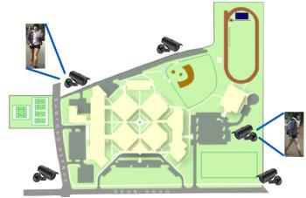
Introduction
Person Re-identification is one of the most demandable research area in current time because of its use in different security purposes.
There are many applications including-
Finding criminals
Protecting VIPs,
Securing authorization etc.
Figure 1: An application scenario of person identification
3

Slide 4
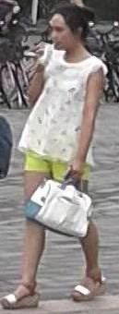
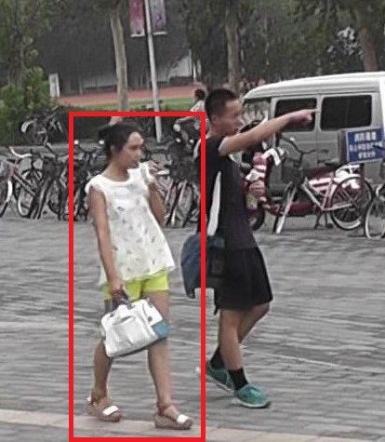
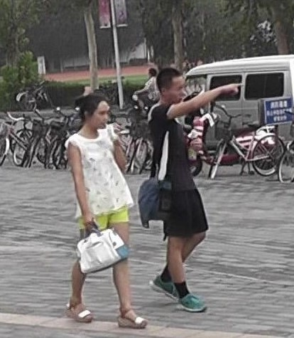
Introduction(cont.)
Multi-view Person Re-identification refers to:
Detecting the person from the image.
Extracting identification features and recognizing from different perspectives.
There are mainly 3 ways:
End-to-End
Two Stage
Sequential
Target Image
Recognizer
Output Image
Gallery Image
Figure 2: Person Identification process in general

Slide 5
Related Works
Munjal et al. [1] modified the OIM [2] model by adding:
A query-guided Siamese squeeze and excitation network
A query-guided region proposal network
A query-guided similarity sub-network and set a new standard of performance in this field.
However, this method requires an ample amount of gallery images and tends to fail in case of low quality images.

Slide 6
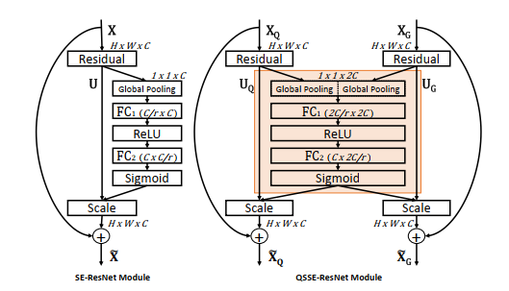
QSSE
Figure: Query guided siamese sqeeze and exictation network

Slide 7
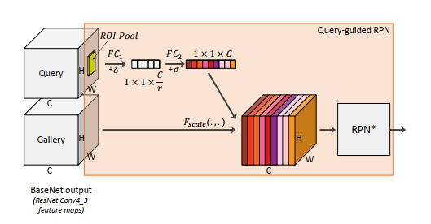
QRPN
Figure : Qeury-Guided Region Proposal Network

Slide 8
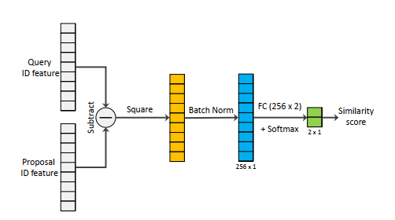
QsimNet
Figure: Query-Guided Similarity Network

Slide 9
Related Works(cont.)
Li et al. [6] designed a sequential model with a Faster R-CNN head, a baseline mode and a context bipartite graph matching algorithm to identify a person.
But it needs to generate a complete bipartite graph for each gallary image which is not efficient and complexity depends on the no. of person in each image.

Slide 10
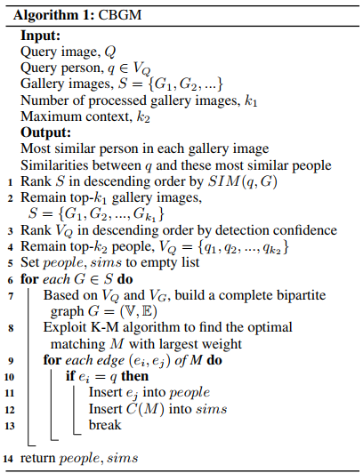
CBGM Algorithm

Slide 11
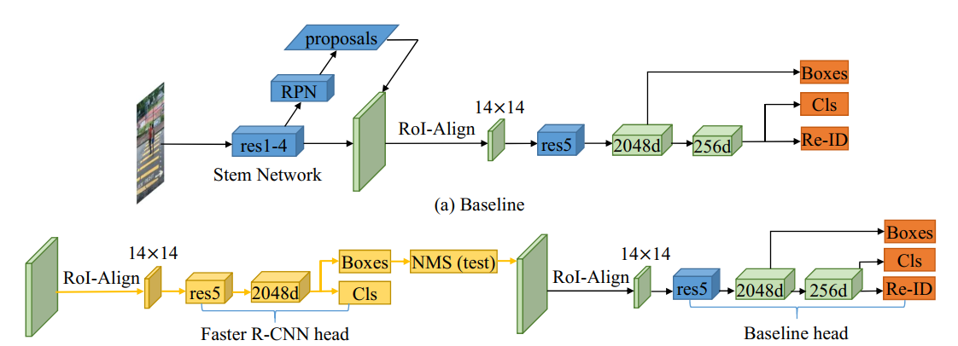
SeqNet Architecture
Figure : SeqNet Architecture

Slide 12
Problem Statement
There are several challenges in this sector:
Ambiguity problem
Critical light condition problem
Occlusion problem
Low quality image problem
Complexity of the matching model
Computational cost

Slide 13
Objective
To develop a computationally effective feature extractor.
To reduce matching time.
To develop a framework.
To analyze the performance of the framework.

Slide 14
Methodology
Input Image
Person Detector
Image Patches
Feature Extractor
Feature Vector
Detector Network
Feature Difference
Similarity Prediction
Target Image
Feature Extractor
Feature Vector
Similarity
Network
Figure 3: Block diagram of the proposed methodology

Slide 15
Methodology: Person Detector
As detection model, Faster R-CNN is widely used [3].
It has 3 main parts:
Region Proposal Network(RPN)
Region of Interest Pooling
Output (Regression and Classification)
Input image is resized such that minimum dimension is 600 px.
Outputs are confidence scores, class labels and coordinates of the bounding boxes.

Slide 16
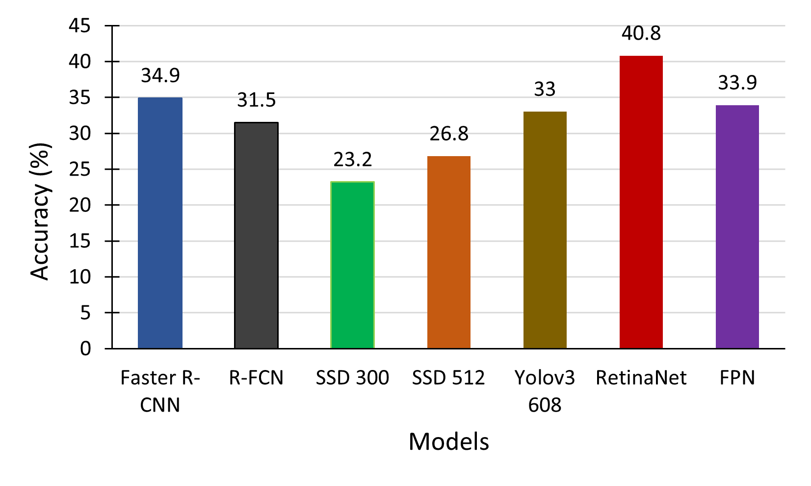
Figure: Accuracy comparison collected from Sanchez et al. work [4]

Slide 17
Detection Model
Region Proposal Network:
Produces bounding box co-ordinates & objectness score of the bounding box area.
Anchor boxes of different sizes that slides over the feature map and IoU > 0.5 are selected for the next stage input.
cls layer
2k scores
reg layer
4k coordinates
sliding window
k anchor boxes
convolution feature map
Figure 7: Anchor box mechanism in RPN

Slide 18
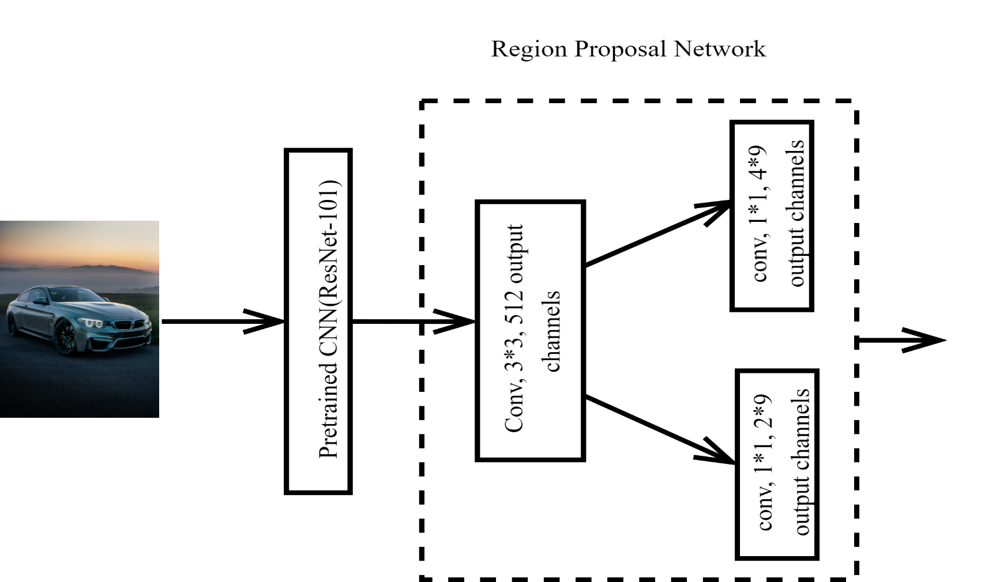
Region Proposal Network
Figure: Region Proposal Network Architecture

Slide 19
Detection Model
Region of Interest Pooling:
Produce fix size feature map from different size region proposals using max pool.
Max pool size is 7*7 and no. of channels are 512.
ROI pooling layer will accept two input:
Region of Interest from RPN
Feature map from Pre-trained model(in this case ResNet-101)

Slide 20
Detection Model
Output (Regression & Classification):
The output of ROI pooling layer is flattened.
Then the flattened output is passed through two fully connected dense layer.
A regression layer and softmax classifier layer is used to predict the confidence score and the class label.

Slide 21
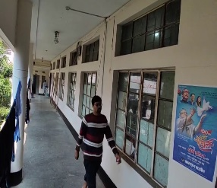
Person Detector (cont.)
Conv, 1*1, 4*9
Regressor
Output ROIs from RPN
Pre-Trained ResNet101
Conv, 3*3, 512
ROI Pooling
FC2, 4096
FC1, 4096
Feature Map from ResNet101
Conv, 1*1, 2*9
Softmax
Region Proposal Network
Figure 4: Overall architecture of Faster R-CNN

Slide 22
Processing
For this purpose several operations can be done:
Histogram equalization
Image up scaling
Sharpening
Noise reduction etc.

Slide 23
Feature Extraction
VGG-16 [7] can be used as it is a widely used feature extractor.
In VGG-16 [7] model, there are:
Thirteen convolutional layers
Five Max Pooling layers
Three Dense layers
Pooling
Pooling
Pooling
Pooling
Pooling
Dense
Input
Dense
Conv 1-1
Conv 2-1
Conv 3-1
Conv 4-1
Conv 5-1
Output
Conv 1-2
Conv 2-2
Conv 3-2
Dense
Conv 3-3
Conv 4-2
Conv 4-3
Conv 5-2
Conv 5-3
Figure 5: Overall Architecture of VGG-16 {7}

Slide 24


Methodology: Similarity Network
The similarity network takes two images : Query and Target.
These images are normalized and resized to 105*105px dimension.
The feature extractor extracts features and based on them similarity prediction is done.
Query Image
Feature Extractor
Feature Vector
Feature Difference
Binary Classifier
Target Image
Feature Extractor
Feature Vector
Figure 5: Block diagram of Similarity Network

Slide 25
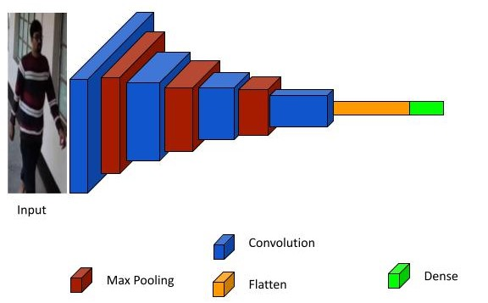
Similarity Network: Feature Extractor
Initially, the proposed feature extractor model of Koch et al. [8] is modified for person re-identification task.
Figure 6: Visualization of modified feature extractor architecture

Slide 26
Feature Extractor (cont.)
Table 1: Modified feature extractor hyper-parameters
Layer Name | Layer Settings | Output Shape
Input | shape = (105x105x3) | 105x105x3
conv2d | 64, 10x10, relu | 96x96x64
max_pooling2d | 64, 2x2, same | 48x48x64
conv2d_1 | 128, 7x7, relu | 42x42x128
max_pooling2d_1 | 64, 2x2, same | 21x21x128
conv2d_2 | 128, 4x4, relu | 18x18x128
max_pooling2d_2 | 64, 2x2, same | 9x9x128
conv2d_3 | 256, 4x4, relu | 6x6x256
flatten | default | 1x9216
dense | 1024, sigmoid | 1x1024

Slide 27
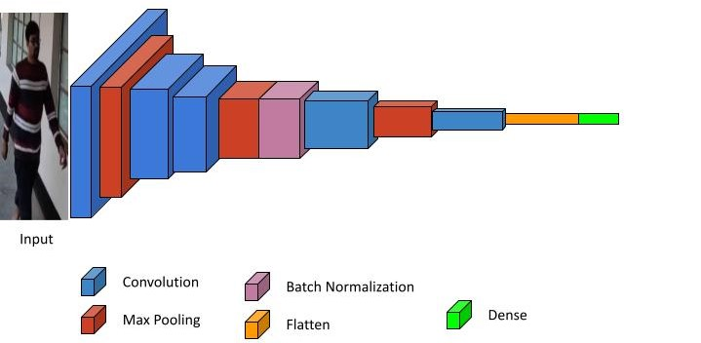
Feature Extractor (cont.)
After that, an efficient and improved model is proposed as feature extractor.
It consist of convolution, max pooling, batch normalization, and dense layers.
Figure 7: Visualization of proposed feature extractor architecture

Slide 28
Feature Extractor (cont.)
Table 2: Proposed feature extractor hyper-parameters
Layer Name | Layer Settings | Output Shape
Input | shape = (105x105x3) | 105x105x3
Conv2d_0 | 32, 11x11, relu | 95x95x32
max_pooling2d_0 | 2x2, same | 48x48x32
conv2d_1 | 64, 9x9, relu | 40x40x64
conv2d_2 | 64, 7x7, relu | 34x34x64
max_pooling2d_1 | 2x2, same | 17x17x64
batch_normalization_1 | default | 17x17x64
conv2d_3 | 128, 5x5, relu | 13x13x128
max_pooling2d_2 | 2x2, same | 7x7x128
conv2d_4 | 256, 3x3, default | 5x5x256
flatten | default | 1x1x6400
dense | 4096, sigmoid | 1x1x4096

Slide 29
Feature Extractor (cont.)
Some pre-trained models are also considered as the feature extractor:
VGG16
VGG19
ResNet50
MobileNetV1
MobileNetV3Large
NASNetMobile
MobileNetV3Small

Slide 30
Feature Extractor (cont.)
Model Name | Top-1 Accuracy (%) | Parameters (in million)
MobileNetV3Small | 68.1 | 2.9
MobileNet1V1 | 70.4 | 4.3
VGG19 | 71.3 | 143.7
VGG16 | 71.3 | 138.4
NASNetMobile | 74.4 | 5.3
ResNet50 | 74.9 | 25.6
MobileNetV3Large | 75.6 | 5.4

Slide 31
Similarity Model
A similarity network is a good choice for this kind of matching purposes.
It usually takes two images and produces the matching result.
Modifying this network with feature vector input can give more robust result.
Figure 6: Modified Architecture of Similarity Network proposed in [1]

Slide 32
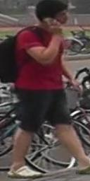
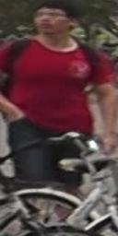
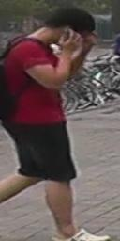




Experiment and Results
In this thesis work two datasets are used: Subset dataset and Real test dataset.
There are 625 different persons images and total 250,000 pairs of images in subset dataset.
225,000 pairs of images are used for training
20,000 pairs of images are used for validation and
10,000 pairs of images are used for testing
Figure 8: Example images from subset dataset

Slide 33
Experiments and Result Analysis (cont.)
Here are some example images from subset dataset.

Slide 34





Experiment and Results (cont.)
The Real test dataset consist of three different persons images
The dataset has two types of images:
The person in image appears larger (Large)
The person in image appear Smaller (Small)
There are total 194 pairs of images in each category.
Figure 9: Example large images from Real test dataset

Slide 35

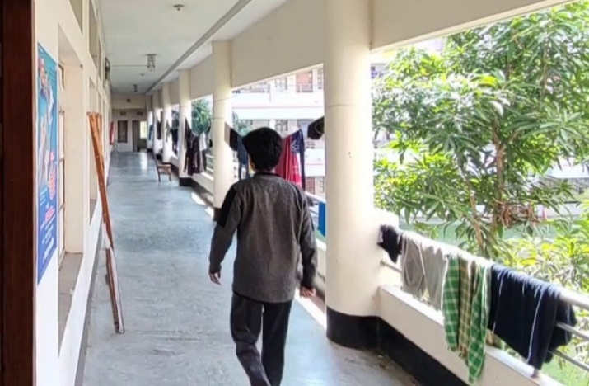
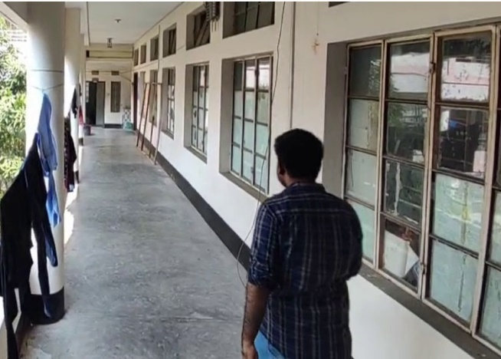
Experiment and Results (cont.)
Here are the example images of small category of Real test dataset.
Figure 10: Example of small images from Real test dataset

Slide 36
Experiment and Results (cont.)
All the experimented models are trained with the same configuration.
Models are early stopped based on the validation F1 score.
All the models are trained by running at most twice If necessary.
Recall, Precision, F1 Score, and Accuracy are considered as evaluation metrics.
Table 3: Training parameters settings
Hyper-parameter | Value
Batch Size | 16
Learning Rate | 1e-4
Optimizer | Adam
Patience | 25

Slide 37
Experiments and Result Analysis (cont.)
In terms of evaluation metrics,
Precision
Recall
F1 score and
Accuracy
are used to evaluated the models.

Slide 38
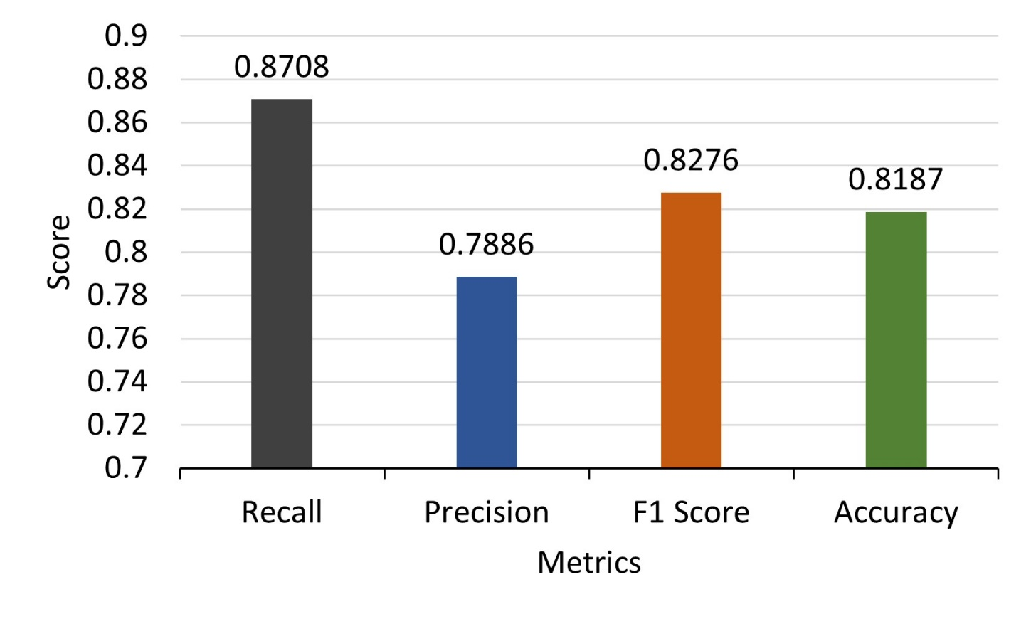
Experiments and Result Analysis (cont.)
Using the feature extractor model proposed in [8], the system achieved a good recall score but couldn’t managed to perform well in other metrics.
Figure 12: Performance of baseline feature extractor model

Slide 39
Experiments and Result Analysis (cont.)
Baseline model’s performance is analyzed by varying the feature vector size.
The model with feature vector size 1024 outperformed all other models in all the metrics.
Table 4: Performance of baseline model with different length of feature vector
Feature Vector Size | Recall | Precision | F1 Score | Accuracy
512 | 0.8662 | 0.7906 | 0.8267 | 0.8184
1024 | 0.8898 | 0.8599 | 0.8746 | 0.8724
2048 | 0.8392 | 0.8047 | 0.8216 | 0.8178
4096 (Baseline) | 0.8708 | 0.7886 | 0.8277 | 0.8187

Slide 40
Experiments and Result Analysis (cont.)
In the baseline model, another convolution layer is added and the performance is analyzed with varying feature vector size.
The model with feature vector size 2048 dominated the recall, accuracy and f1 score metrics.
Best precision is archived by the model with 4096 length feature vector size.
Table 5: Performance of baseline model with five convolution layer and different length of feature vector size
Feature Vector Size | Recall | Precision | F1 Score | Accuracy
512 | 0.8396 | 0.8040 | 0.8214 | 0.8175
1024 | 0.8764 | 0.7263 | 0.8233 | 0.8119
2048 | 0.8992 | 0.8020 | 0.8478 | 0.8386
4096 | 0.8602 | 0.8191 | 0.8391 | 0.8351

Slide 41
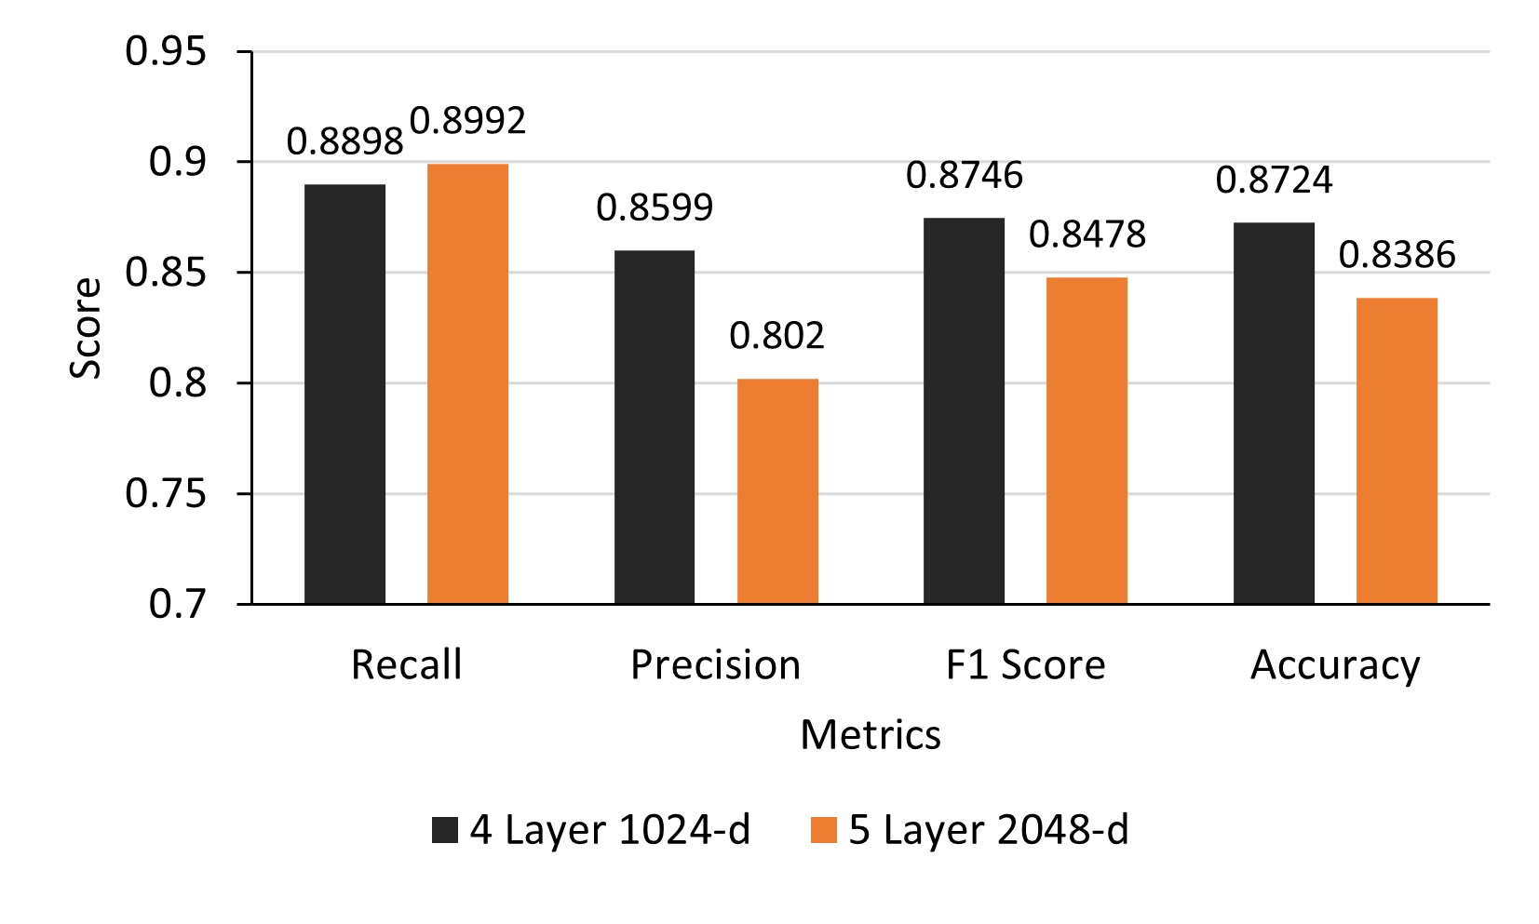
Experiment and Results (cont.)
Apart from recall, 4 layer 1024-d model achieved best score in all other metrics.
Figure 11: Comparison between 4 layer best and 5 layer best model

Slide 42
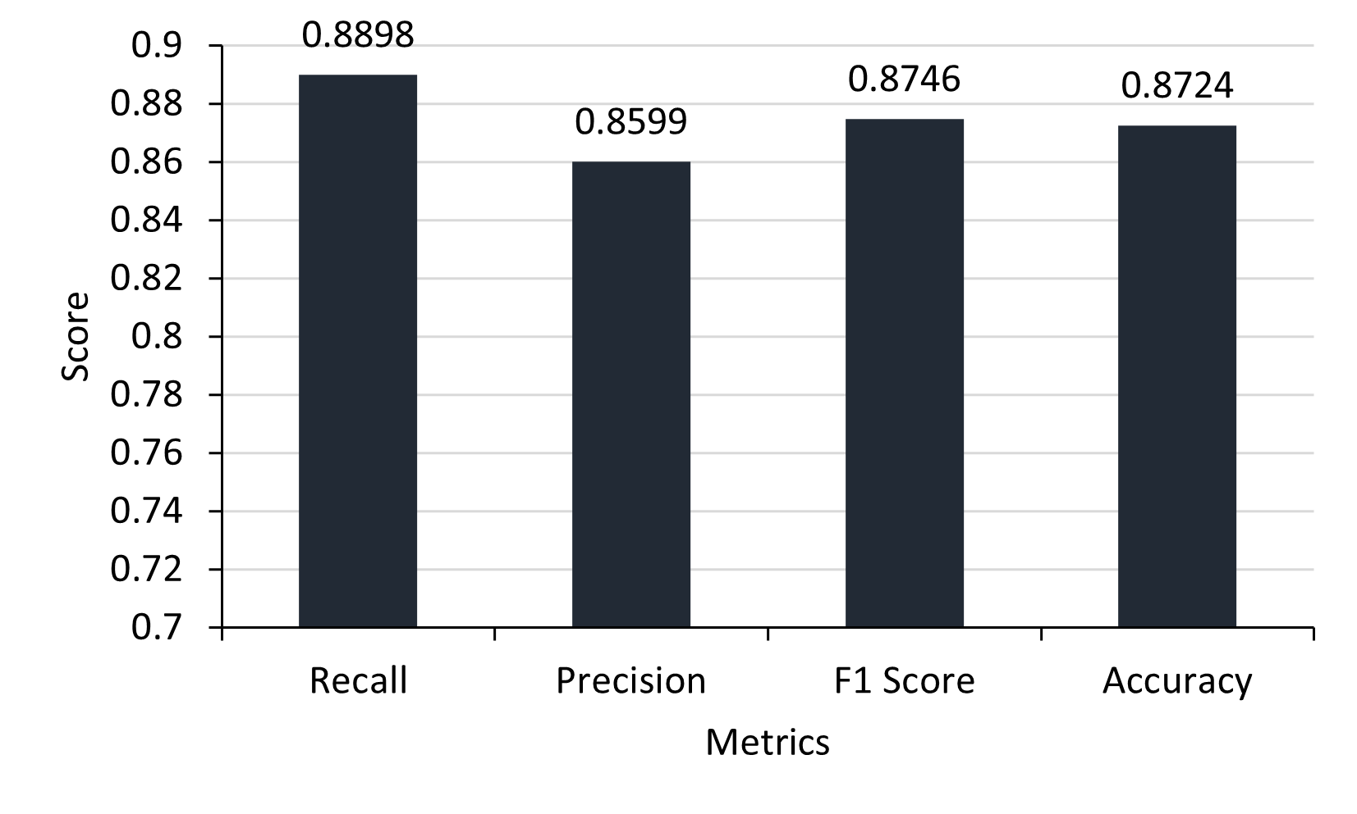
Experiment and Results (cont.)
The modified model with 1024 feature vector size has achieved a overall good score in all four metrics.
Figure 11: Performance of modified model on subset dataset

Slide 43
Experiments and Result Analysis (cont.)
A dropout layer is added after the final convolution layer and performance is recorded by varying the dropout rate.
It is observed that using dropout doesn’t provide good score in this task and as the rate increases the performance decreases.
Table 6: Performance of 5 layer baseline model with different dropout rate
Dropout Rate (%) | Recall | Precision | F1 Score | Accuracy
0 | 0.8602 | 0.8191 | 0.8391 | 0.8351
20 | 0.8706 | 0.7987 | 0.8331 | 0.8257
30 | 0.7934 | 0.8201 | 0.8065 | 0.8097
40 | 0.7616 | 0.8364 | 0.7972 | 0.8063
50 | 0.6498 | 0.8213 | 0.7256 | 0.7542

Slide 44
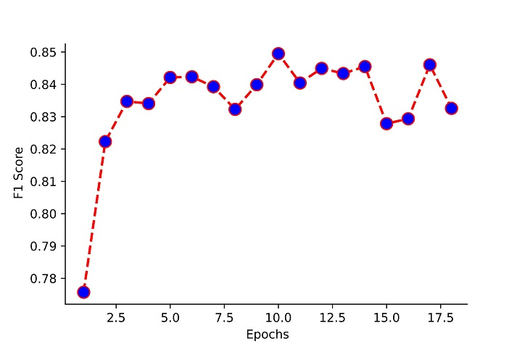
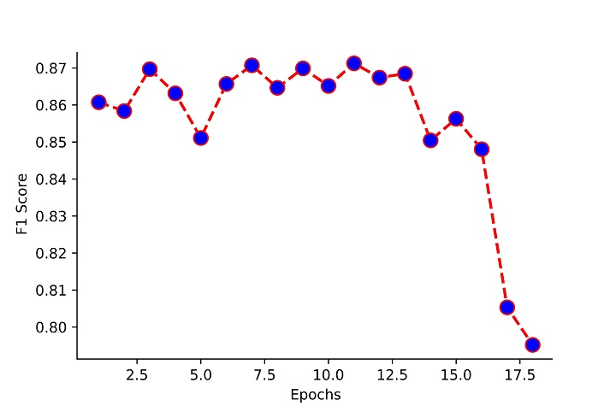
Experiment and Results (cont.)
(a)
(b)
Figure 12: Epoch vs F1 score curve of training for modified model (a) Run 1 (b) Run 2

Slide 45
Experiments and Result Analysis (cont.)
Performance of the proposed model is analyzed after removing the batch normalization layer and varying the feature vector size.
The model with feature vector size 512 performed better than others in this case.
Table 7: Performance of the proposed model without batch normalization layer and varying feature vector size
Feature Vector Size | Recall | Precision | F1 Score | Accuracy
512 | 0.8958 | 0.8364 | 0.8650 | 0.8603
1024 | 0.9156 | 0.7826 | 0.8439 | 0.8306
2048 | 0.8974 | 0.7823 | 0.8416 | 0.8331
4096 | 0.9104 | 0.8004 | 0.8517 | 0.8415

Slide 46
Experiments and Result Analysis (cont.)
Using the proposed model presented in figure [8], it is observed that the model with 1024 feature vector size performed well. The model consist of only one batch normalization layer.
Table 8: Performance of the proposed model with one batch normalization layer and varying feature vector size
Feature Vector Size | Recall | Precision | F1 Score | Accuracy
512 | 0.8982 | 0.7950 | 0.8434 | 0.8333
1024 | 0.908 | 0.8396 | 0.8724 | 0.8673
2048 | 0.9416 | 0.7985 | 0.8641 | 0.852
4096 | .0.9068 | 0.7860 | 0.8421 | 0.83

Slide 47
Experiments and Result Analysis (cont.)
After adding two more batch normalization layers at the beginning and at the last, it is observed that the model with feature vector size 4096 performed better than others.
Table 9: Performance of the proposed model with three batch normalization layer and varying feature vector size
Feature Vector Size | Recall | Precision | F1 Score | Accuracy
512 | 0.9204 | 0.7924 | 0.8516 | 0.8396
1024 | 0.9324 | 0.8067 | 0.8650 | 0.8545
2048 | 0.922 | 0.8175 | 0.8668 | 0.8583
4096 | 0.9288 | 0.8215 | 0.8717 | 0.8635

Slide 48
Experiment and Results (cont.)
The model with one batch normalization layer and 1024 feature vector size performs well in three evaluation metrics.
Table 4: Comparing best models with different number of batch normalization layers
Model | Recall | Precision | F1 Score | Accuracy
512-NO-Batch Normalization | 0.8958 | 0.8364 | 0.8650 | 0.8603
1024-One-Batch Normalization | 0.908 | 0.8396 | 0.8724 | 0.8673
4096-Three-Batch Normalization | 0.9288 | 0.8215 | 0.8717 | 0.8635

Slide 49
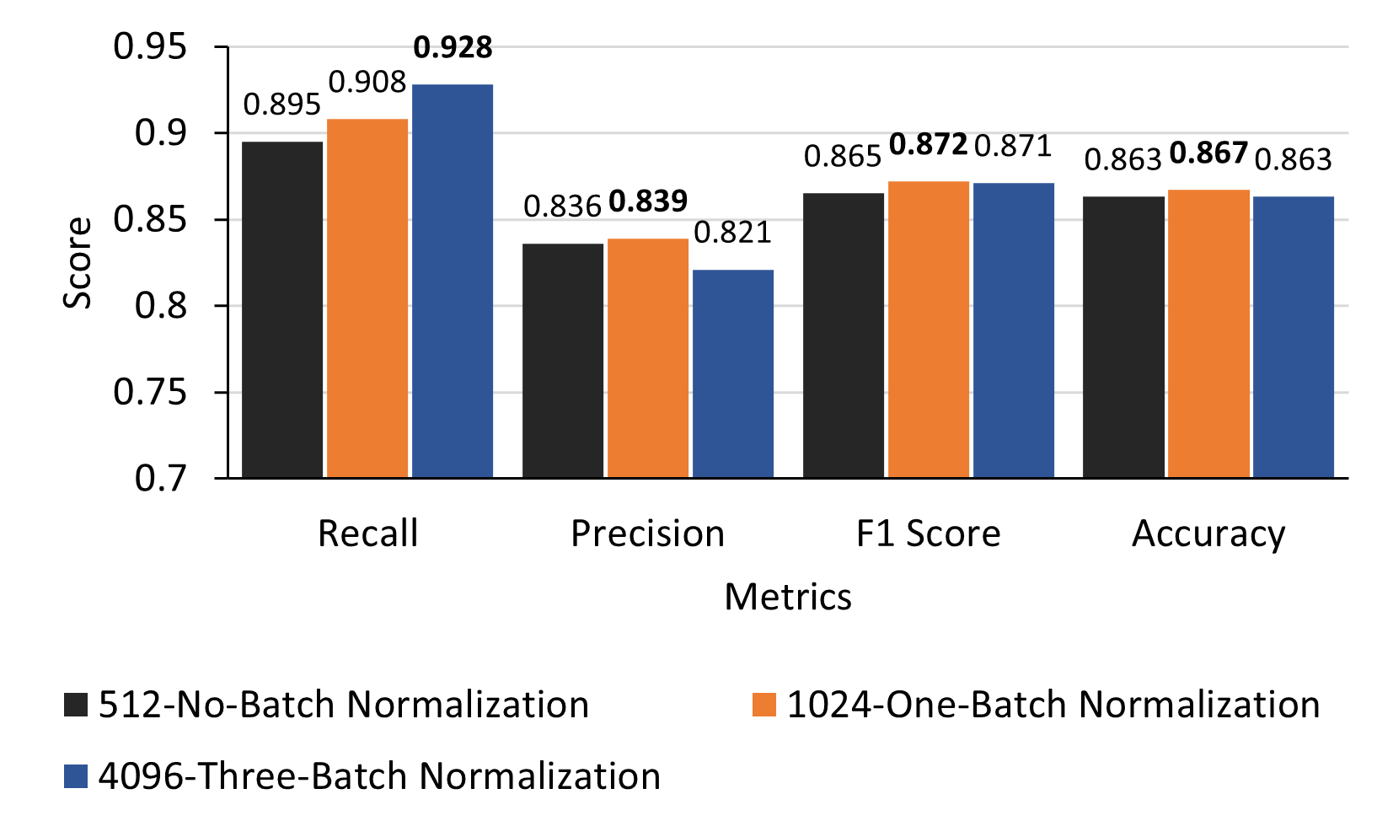
Experiment and Results (cont.)
The model with one batch normalization layer and 1024 feature vector size performs well in three evaluation metrics.
Figure 13: Comparison between models with different batch normalization layers

Slide 50
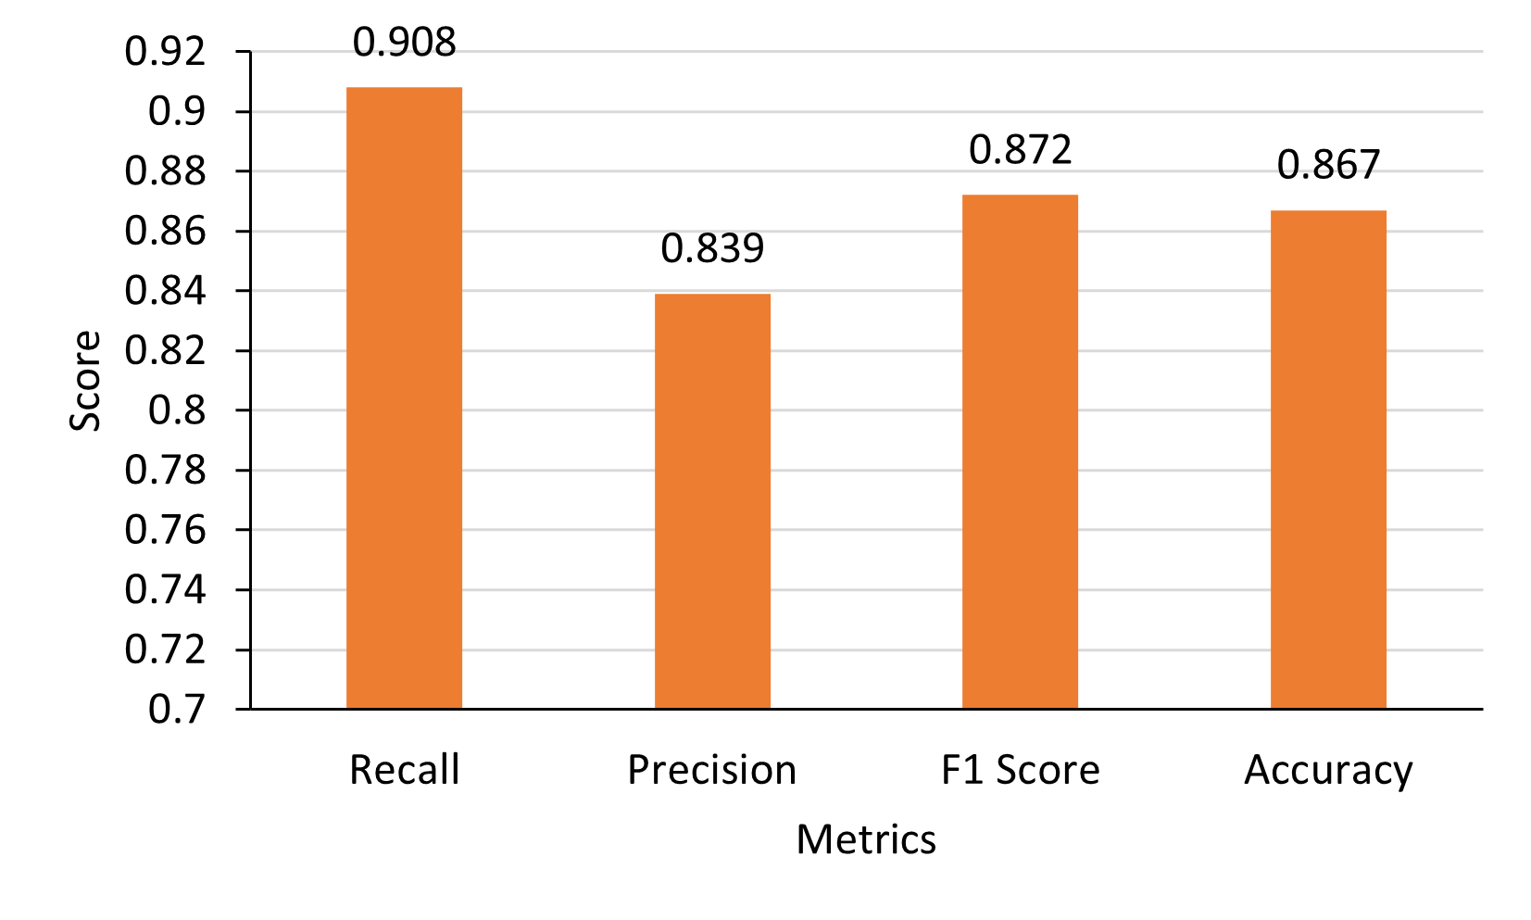
Experiment and Results (cont.)
The proposed model with 1024 feature vector size has achieved a very good recall score with decent precision, f1 score, and accuracy value.
Figure 13: Performance of proposed model on subset test dataset

Slide 51
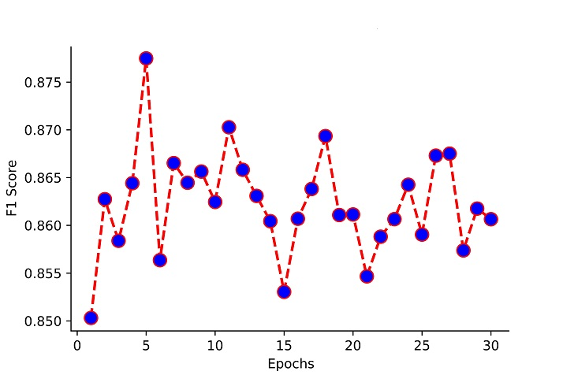
Experiment and Results (cont.)
Figure 14: Epoch vs F1 score curve of training for proposed model

Slide 52
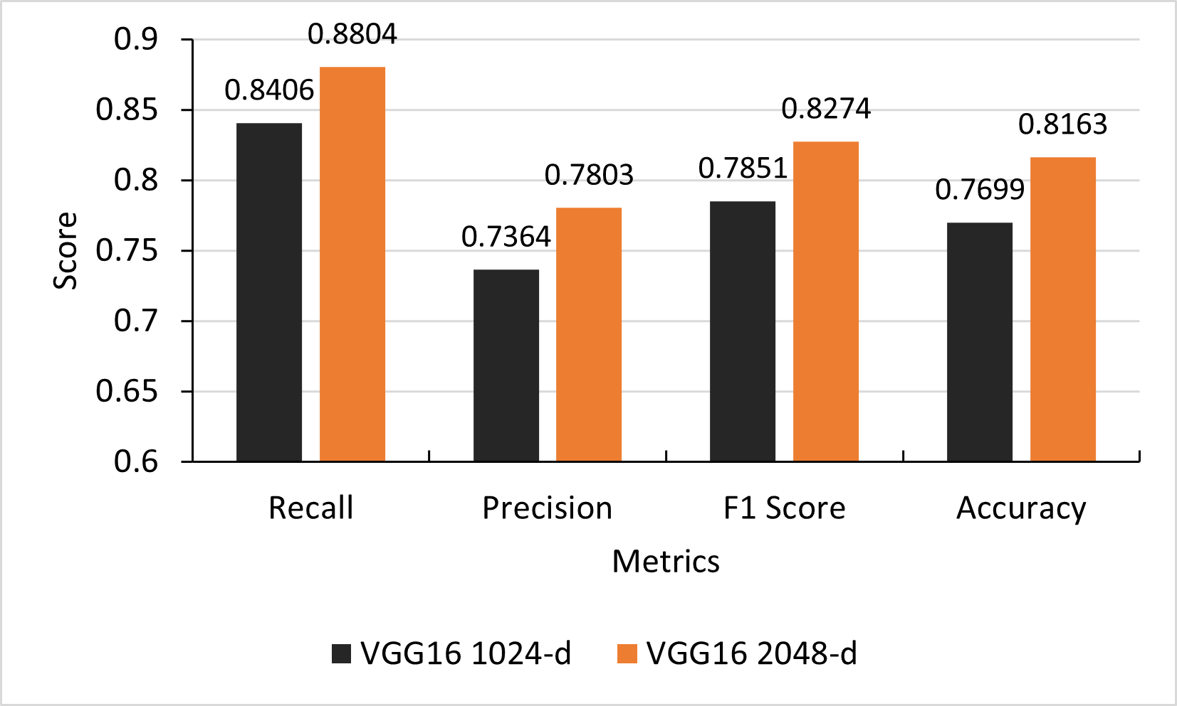
Experiments and Result Analysis (cont.)
Using the pre-trained VGG16 model with different feature vector size, it is observed that feature vector of length 2048 performs better.
Figure 16: Comparison of pre-trained VGG16 models with different feature vector size

Slide 53
Experiment and Results (cont.)
Analyzing the performance of different pre-trained models, it can be concluded that VGG16 model outperforms all the other models.
Table 4: Performance of pre-trained models with 2048 feature vector size
Model | Recall | Precision | F1 Score | Accuracy
VGG16 | 0.8804 | 0.7803 | 0.8274 | 0.8163
VGG19 | 0.8478 | 0.6537 | 0.7382 | 0.6994
ResNet50 | 0.7484 | 0.7056 | 0.7264 | 0.7181
MobileNetV1 | 0.858 | 0.7658 | 0.8092 | 0.7879
MobileNetV3Small | 0.8444 | 0.7025 | 0.7669 | 0.7434
MobileNetV3Large | 0.8104 | 0.6967 | 0.7492 | 0.7288
NASNetMobile | 0.8594 | 0.7011 | 0.7722 | 0.7465

Slide 54
Experiment and Results (cont.)
The Modified model performed better in accuracy, f1 score and precision.
But the proposed model gets the maximum recall score.
Table 5: Comparison among the best models
Model | Recall | Precision | F1 Score | Accuracy
Pre-trained Best | 0.8804 | 0.7803 | 0.8274 | 0.8163
Modified | 0.8898 | 0.8599 | 0.8746 | 0.8724
Proposed | 0.908 | 0.8396 | 0.8724 | 0.8673

Slide 55
Experiment and Results (cont.)
Table 6: Complexity comparison between modified and proposed models
Table 7: Comparison between proposed and modified models in terms of speed
Feature Vector Size | Parameters in Modified Architecture (millions) | Parameters in Proposed Architecture (millions)
512 | 5.9 | 4.1
1024 | 10.6 | 7.4
2048 | 20 | 13.9
4096 | 38.9 | 27
Model | Average train time per epoch (ms) | Average evaluation time per image (ms)
Modified | 310 | 9.4
Proposed | 24 | 0.04

Slide 56
Experiments and Result Analysis (cont.)
In terms of speed, the proposed model performs more that 200 times faster than the modified best model.
Table 8: Comparison between proposed and modified models in terms of speed
Model | Average train time per epoch (ms) | Average evaluation time per epoch (ms)
1024-Modified | 310 | 9.4
1024-One-BN | 24 | 0.04

Slide 57
Experiment and Results (cont.)
Previously, all the models were tested on subset dataset.
Now, the models are tested on Real test dataset.
Table 8: Performance of models on Large category of Real test data
Table 9: Performance of models on Small category of Real test data
Model | Recall | Precision | F1 Score | Accuracy
Pre-trained Best | 0.7319 | 0.6454 | 0.6869 | 0.6649
Modified | 0.8763 | 0.5483 | 0.6746 | 0.5773
Proposed | 0.7938 | 0.6062 | 0.6874 | 0.6393
Model | Recall | Precision | F1 Score | Accuracy
Pre-trained Best | 0.5979 | 0.5087 | 0.5497 | 0.5103
Modified | 0.6185 | 0.5454 | 0.5797 | 0.5515
Proposed | 0.8144 | 0.4876 | 0.61 | 0.4793

Slide 58
Experiments and Result Analysis (cont.)
Previously, all the models were tested on subset dataset.
Now, the models are tested on Real test dataset.
Table 15: Performance of models on Large category of Real test data
Model | Recall | Precision | F1 Score | Accuracy
VGG16 | 0.7319 | 0.6454 | 0.6869 | 0.6649
VGG19 | 0.7423 | 0.6421 | 0.6792 | 0.6794
ResNet50 | 0.5773 | 0.5 | 0.53 | 0.5
MobileNetV1 | 0.7423 | 0.5902 | 0.6575 | 0.6135
MobileNetV3Small | 0.7938 | 0.6209 | 0.6968 | 0.6546
MobileNetV3Large | 0.8350 | 0.5548 | 0.6667 | 0.5824
NASNetMobile | 0.8763 | 0.5414 | 0.6692 | 0.5670
1024-Modified | 0.8763 | 0.5483 | 0.6746 | 0.5773
1024-One-BN | 0.7938 | 0.6062 | 0.6874 | 0.6393

Slide 59
Experiments and Result Analysis (cont.)
Table 16: Performance of models on Small category of Real test data
Model | Recall | Precision | F1 Score | Accuracy
VGG16 | 0.5979 | 0.5087 | 0.5497 | 0.5103
VGG19 | 0.8649 | 0.4907 | 0.6315 | 0.4948
ResNet50 | 0.5567 | 0.5192 | 0.5373 | 0.5206
MobileNetV1 | 0.9072 | 0.5301 | 0.6692 | 0.5515
MobileNetV3Small | 0.6082 | 0.5619 | 0.5841 | 0.5670
MobileNetV3Large | 0.8453 | 0.5222 | 0.6456 | 0.5360
NASNetMobile | 0.5154 | 0.5952 | 0.5524 | 0.5824
1024-Modified | 0.6185 | 0.5454 | 0.5797 | 0.5515
1024-One-BN | 0.8144 | 0.4876 | 0.61 | 0.4793

Slide 60
Experiments and Result Analysis (cont.)
Table 16: Performance of models on Small category of Real test data
Model | Recall | Precision | F1 Score | Accuracy
VGG16 | 0.5979 | 0.5087 | 0.5497 | 0.5103
1024-Modified | 0.6185 | 0.5454 | 0.5797 | 0.5515
1024-One-BN | 0.8144 | 0.4876 | 0.61 | 0.4793

Slide 61
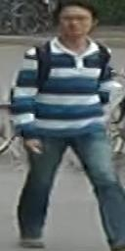
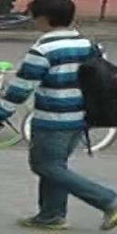
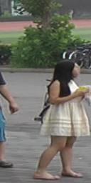
Experiments and Result Analysis (cont.)
Target
(a) Query 1 (0.98)
(b) Query 2 (5e-4)
(c) Query 3 (0.02)
Figure 17: Outputs using modified model on subset dataset

Slide 62
Experiment and Results (cont.)
Target
(a) Query 1 (0.98)
(b) Query 2 (5e-4)
(c) Query 3 (0.002)
Figure 15: Outputs using modified model on subset dataset
Target
(a) Query 1 (0.99)
(b) Query 2 (1e-5)
(c) Query 3 (5e-5)
Figure 16: Outputs using proposed model on subset dataset

Slide 63

Experiment and Results (cont.)
Target
(a) Query 1 (0.96)
(b) Query 2 (0.26)
(c) Query 3 (0.85)
Figure 17: Outputs using modified model on Real test data (Large)
Target
(a) Query 1 (0.99)
(b) Query 2 (0.12)
(c) Query 3 (0.92)
Figure 18: Outputs using proposed model on Real test data (Large)

Slide 64
Experiments and Result Analysis (cont.)
Target
(a) Query 1 (0.99)
(b) Query 2 (0.12)
(c) Query 3 (0.92)
Figure 19: Outputs using proposed model on Real test data (Large)

Slide 65
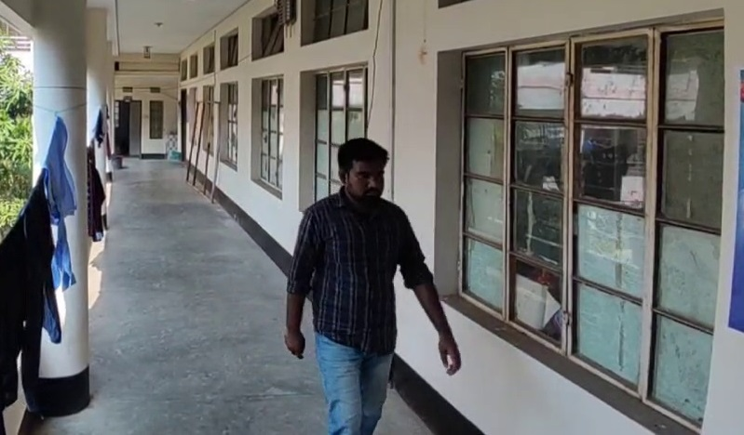
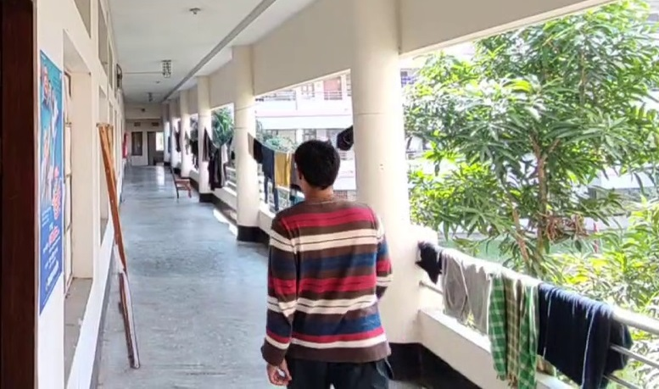
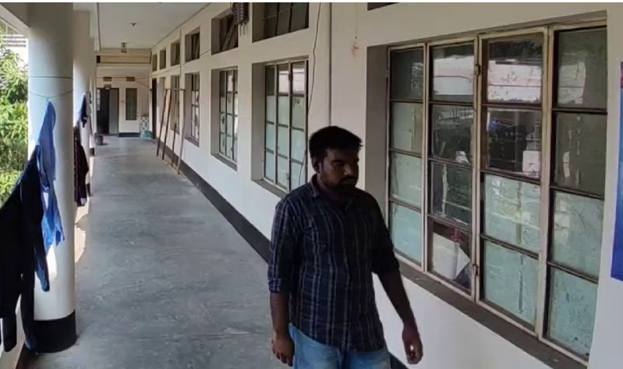
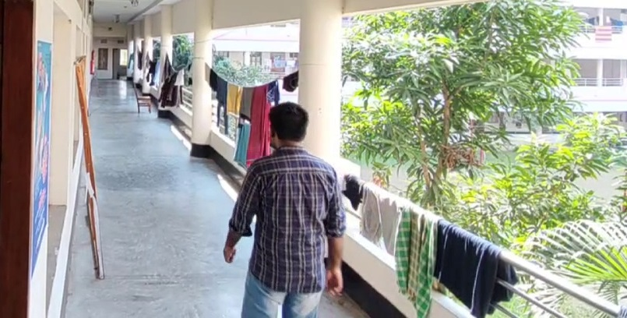
Experiment and Results (cont.)
Target
(a) Query 1 (0.56)
(b) Query 2 (0.98)
(c) Query 2 (0.36)
Figure 19: Outputs using modified model on Real test data (Small)

Slide 66
Experiment and Results (cont.)
Target
(a) Query 1 (0.002)
(b) Query 2 (0.92)
(c) Query 2 (0.69)
Figure 20: Outputs using proposed model on Real test data (Small)

Slide 67

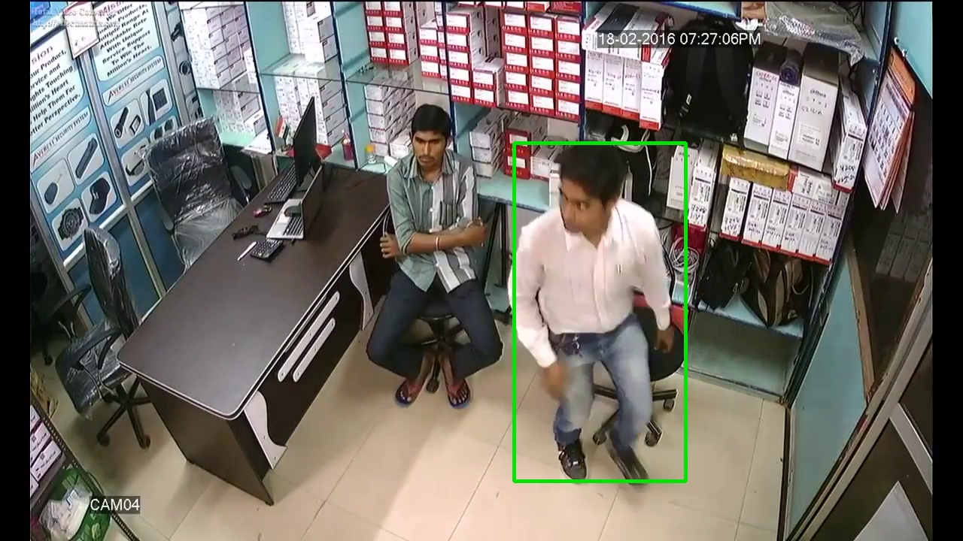

Experiment and Results (cont.)
(a) Target Person
(b) Target person detected in a frame
(c) Result (0.88)
Figure 21: Demonstration of the proposed Person Re-identification system

Slide 68
Limitations
Person detector network is a bottleneck for the system.
Didn’t consider low lighting conditions and different scaled inputs.
Provides less generalization for the lack of train data.
Didn’t consider grayscale images as inputs.
Incompatible for online application but compatible for offline application.

Slide 69
Future Work
A custom lightweight person detector network can improve the performance of the system.
Dataset with more lighting and scale variation can help in better generalization.
Residual network can be added to create more deeper network.

Slide 70
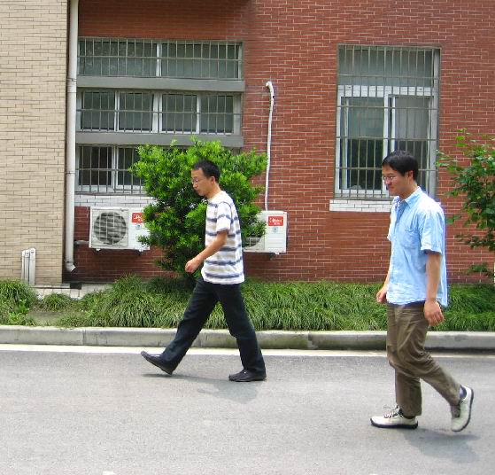
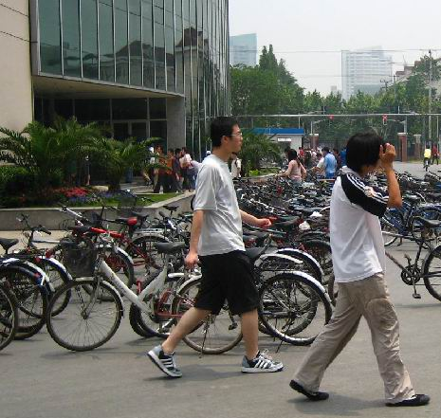
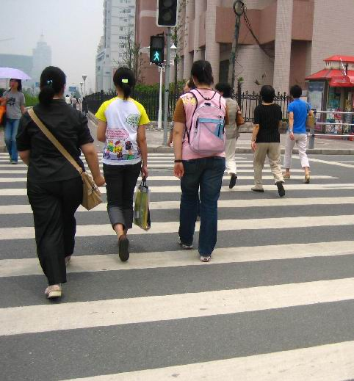
Implementation
Initially Penn-Fudan Dataset [8] is used for testing performance of Faster R-CNN model.
There are 170 images with 345 labeled pedestrians.
Among these, 96 images are taken from around University of Pennsylvania.
Other 74 images are taken from around Fudan University.
Figure 7: Images from Penn-Fudan Dataset

Slide 71
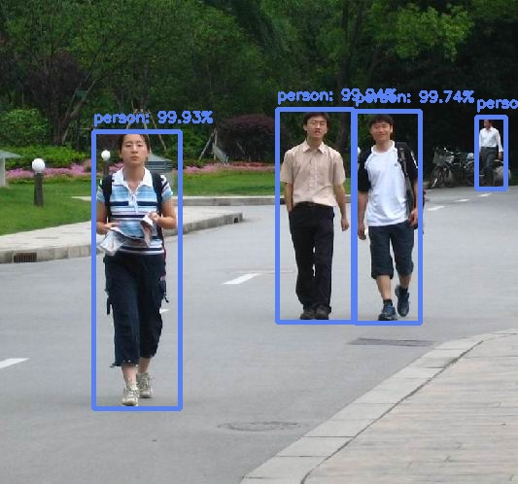
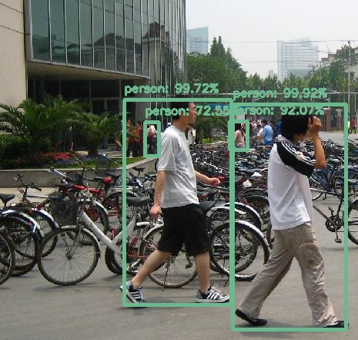
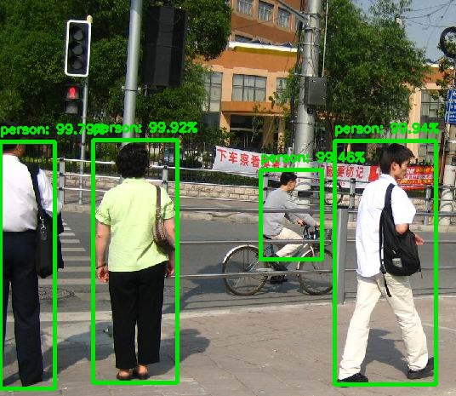
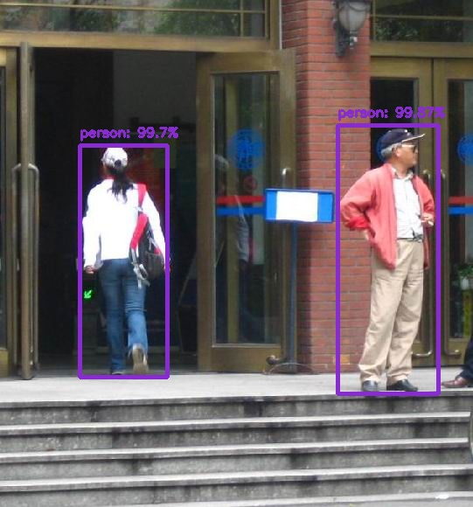
Implementation(cont.)
Images are used from Penn-Fudan Dataset.
Figure 8: Performace of Faster R-CNN on image data

Slide 72
Limitation of Gray-scale Image
Person identification in grayscale image is one of the most challenging task.
Grayscale image lacks the color information which is considered the most important feature in case of “Short term person identification”.
Grayscale image contains only one channel where as RGB image contains 3 channels so grayscale image lacks many valuable information.
Grayscale image are more prone to false detection because often bright color in RGB image tends to have similar representation in grayscale.

Slide 73
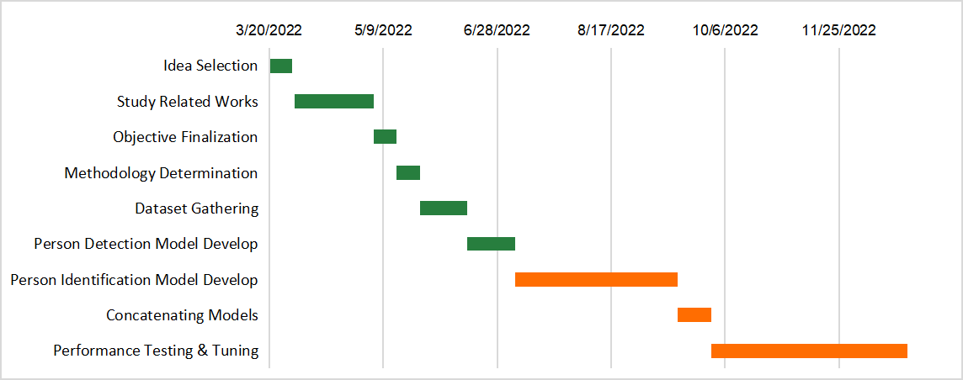
Total Progress Using Gantt Chart
Total progress is presented on a gantt chart.
Completed
Due
Figure 9: Total progress Gantt chart

Slide 74
Conclusion
A computationally efficient model is proposed that is more faster than the usual model.
A local dataset is created and model’s performance is evaluated on the dataset.
A framework for person re-identification is proposed.
Future works are discussed.

Slide 75
Publication
Paper ID : 374
Paper Title : Person Re-identification: A Lightweight Feature Extraction Architecture for Image Based Methods
Accepted for presentation at “3rd International Conference on Electrical, Computer & Communication Engineering”, CUET, Chittagong, Bangladesh.

Slide 76
References
Munjal, Bharti, et al. "Query-guided end-to-end person search." Proceedings of the IEEE/CVF Conference on Computer Vision and Pattern Recognition. 2019.
Xiao, Tong, et al. "Joint detection and identification feature learning for person search." Proceedings of the IEEE conference on computer vision and pattern recognition. 2017.
Ren, Shaoqing, et al. "Faster r-cnn: Towards real-time object detection with region proposal networks." Advances in neural information processing systems 28 (2015).
Sanchez, S. A., H. J. Romero, and A. D. Morales. "A review: Comparison of performance metrics of pretrained models for object detection using the TensorFlow framework." IOP Conference Series: Materials Science and Engineering. Vol. 844. No. 1. IOP Publishing, 2020.
Li, Zhengjia, and Duoqian Miao. "Sequential end-to-end network for efficient person search." Proceedings of the AAAI Conference on Artificial Intelligence. Vol. 35. No. 3. 2021.
Simonyan, Karen, and Andrew Zisserman. "Very deep convolutional networks for large-scale image recognition." arXiv preprint arXiv:1409.1556 (2014).
Wang, Liming, et al. "Object detection combining recognition and segmentation." Asian conference on computer vision. Springer, Berlin, Heidelberg, 2007.
Koch, G., Zemel, R., & Salakhutdinov, R. (2015, July). Siamese neural networks for one-shot image recognition. In ICML deep learning workshop (Vol. 2, No. 1).

Slide 77
Thank You
Any Question ?

